Slide 1
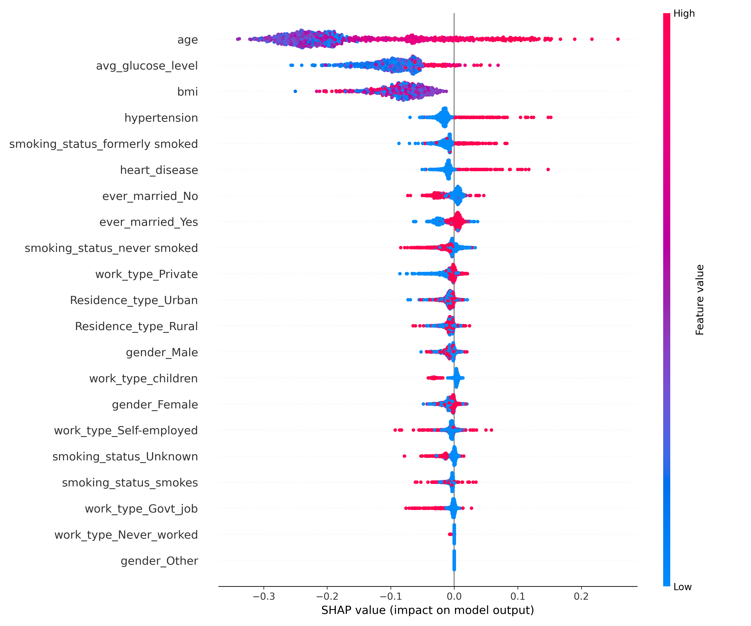
As data scientist
Feature Importance and Model Focus:
  The model relies heavily on age, avg_glucose_level, bmi, and hypertension, with age being the most influential one.
  The features at the bottom, such as work type, have very minimal influence on the output and could potentially be removed.
Feature Impact:
  Positive Impact: Positive SHAP values increase the predicted stroke risk, as can be seen with age, avg_glucose_level, and so on where high values push the risk higher.
  Negative Impact: age, hypertension, heart_disease and so on demonstrates that lower values push the risk lower.
Feature Interaction and Distribution:
  The features like hypertension, heart disease, and the binary ever married Yes/No are clustered more tightly as they are binary features where the effect is either on or off.
  The large, distinct spread for age, avg_glucose_level, and bmi suggests that their impact on the prediction is not uniform and might depend heavily on their interaction with other features or that the relationship is highly non-linear.
Feature Encoding and Imputation Assessment:
  Encoded features such as (e.g., ever_married_Yes and ever_married_No) are showing compensatory effect which is the expected behaviour.
  The missing values of BMI was imputed using KNN method. It does seem like the high values are mostly increasing the risk after the imputation.

Slide 2
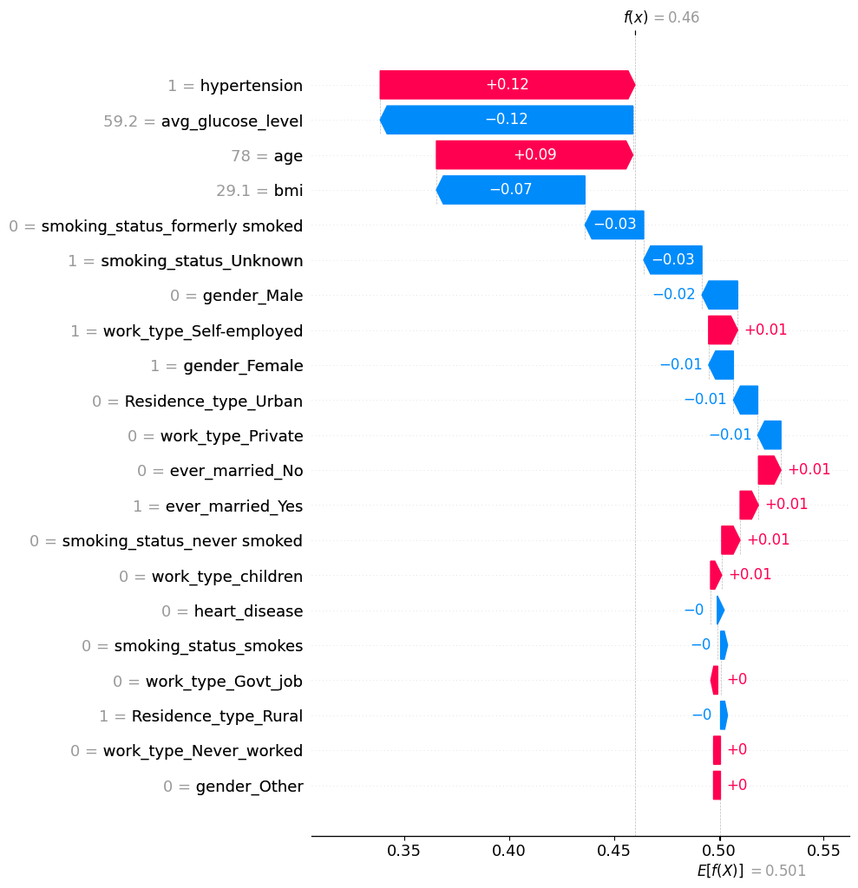
As Doctor
The Baseline Risk and Final Prediction:
  The model’s expected baseline prediction is 0.501 for a patient. This specific patient has a prediction value of 0.46, which is lower than average but pretty close to a risky level.
Key Risk Factors:
  Risk Reducers (Blue Bars): The low glucose level is the largest risk reducer for this patient. Similarly, BMI also helps reduce the risk further. Also, the fact that his smoking habit is unknown is captured positively by the model, as it assumes that the patient is not a previous or current smoker. Gender also seems to reduce the risk for this patient, but it is not medically actionable.
  Risk Aggravators (Red Bars): The hypertension of this patient creates the biggest risk. The advanced age, while not medically actionable, also contributes to the risk and the patient needs to be made aware of this. Some other features which also add to the risk are not medically actionable.
Conclusion:
  The doctor should advise the patient to continue controlling his low glucose level and BMI.
  The patient should be advised to control her hypertension as it is the biggest risk factor.
  The patient should be advised to control these factors as advancing age is not medically actionable and the risk value is dangerously close to average.

Slide 3
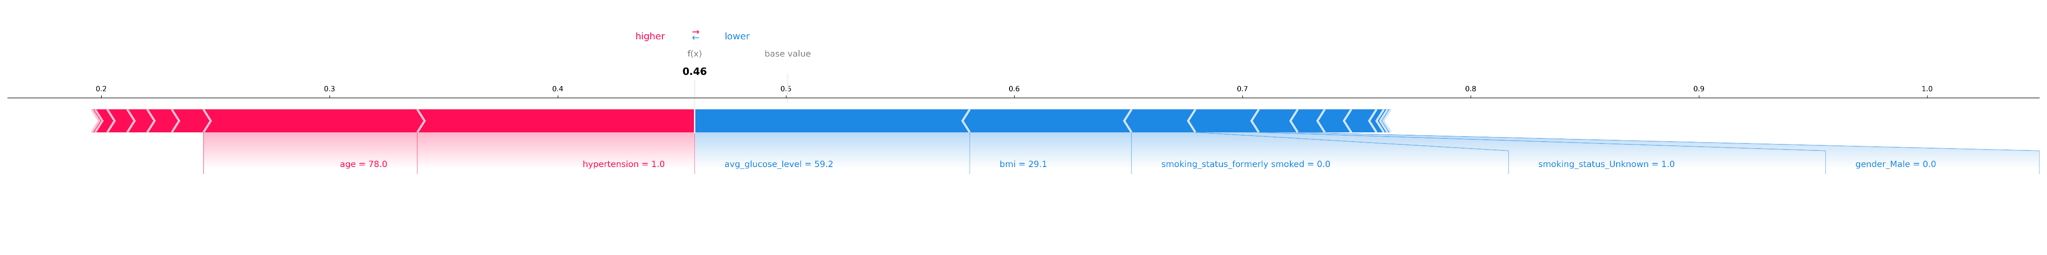
As Patient
The Baseline and the Final Risk:
  The force plot shows the base risk at 0.50 and the patient risk at 0.46, which implies that the patient has risk lower than average but too close to the danger level.
The Important Factors:
  Pushing Risk UP (Red Arrows): Hypertension and age are the two biggest red forces in this plot. As age cannot be controlled, hypertension is the only factor that can be reduced.
  Pulling Risk DOWN (Blue Arrows): BMI and low glucose level seem to be the biggest blue forces. While the model assumes that unknown smoking habit of the patient is a positive sign, it can turn from a blue force to a red one if there was any smoking history.
Conclusion:
  As the age risk will only go up, the patient needs to lower the other red features to compensate for that and increase the blue features alongside that. On that note, the patient needs to control hypertension and continue managing and perhaps reduce the glucose level and BMI.

